Slide 1
Introduction to Deep Learning
Subhajit Paul
HRDPD, SIPG

Slide 2
Overview
Machine learning v/s Deep Learning
Artificial Neuron and inspiration from our brain functionality
Perceptron
Definition and visualization of its limitation
MLP and its representational Power
MLP learning algorithm
Multilayer Neural Network or Artificial Neural Network(ANN)
Defining terminologies
Backpropagation algorithm with chain rule
Different activation functions
Convolutional Neural Network(CNN)
Convolution Operation and its different parameters
Case study of different CNN model architectures
Different python libraries and steps to train a deep learning model
Generative and discriminative network and introduction to GAN
Brief introduction to RNNs
Different applications of Deep learning model in vision field

Slide 3
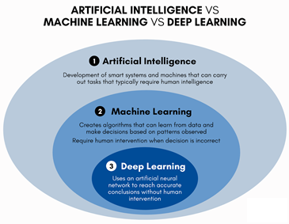
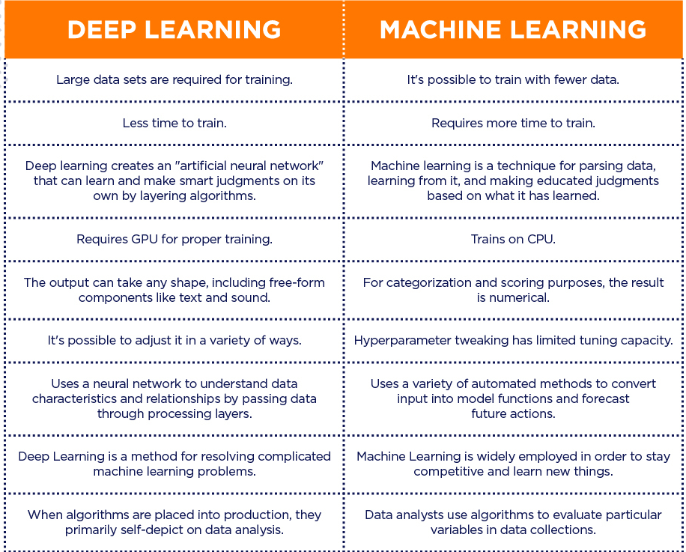
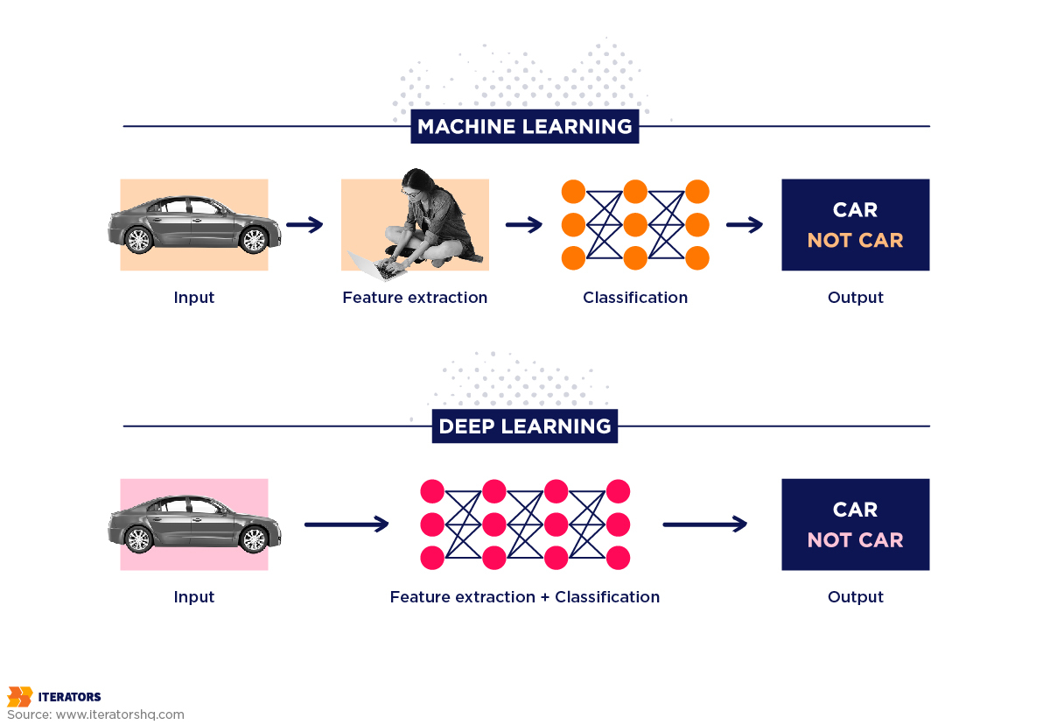
Machine Learning v/s Deep Learning

Slide 4
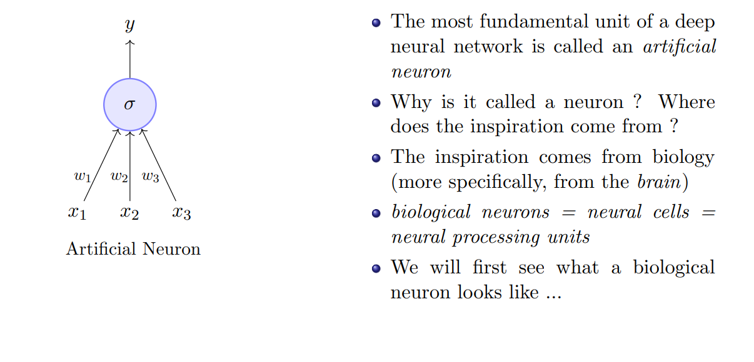
Artificial Neuron

Slide 5
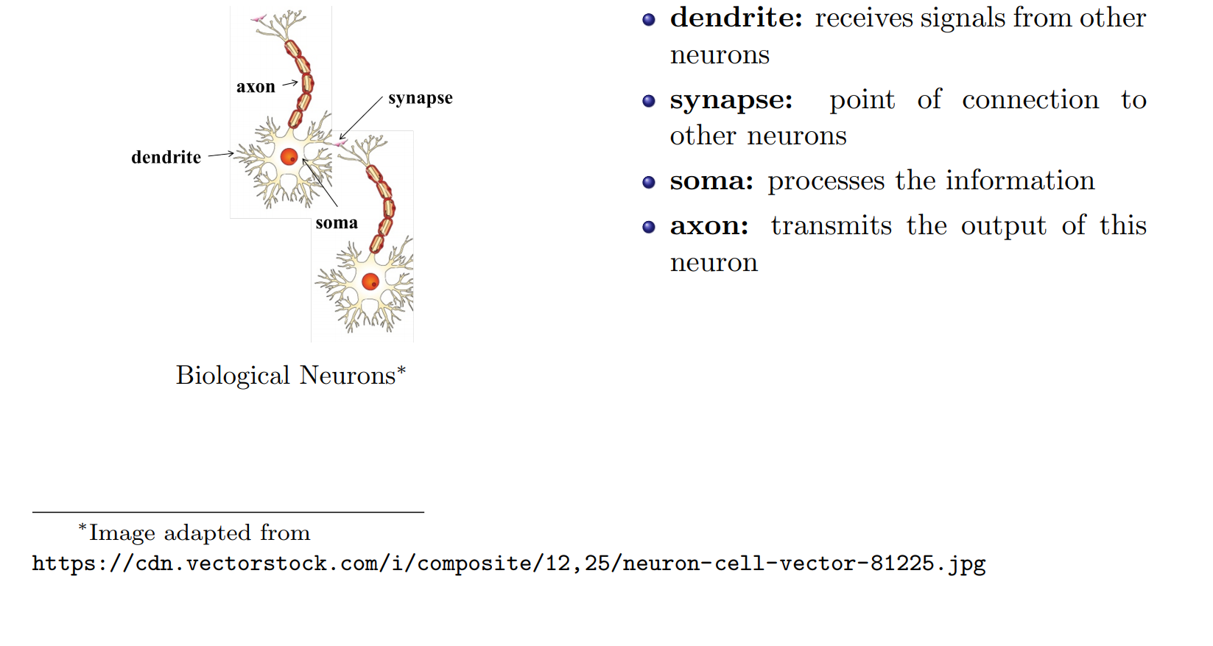

Slide 6
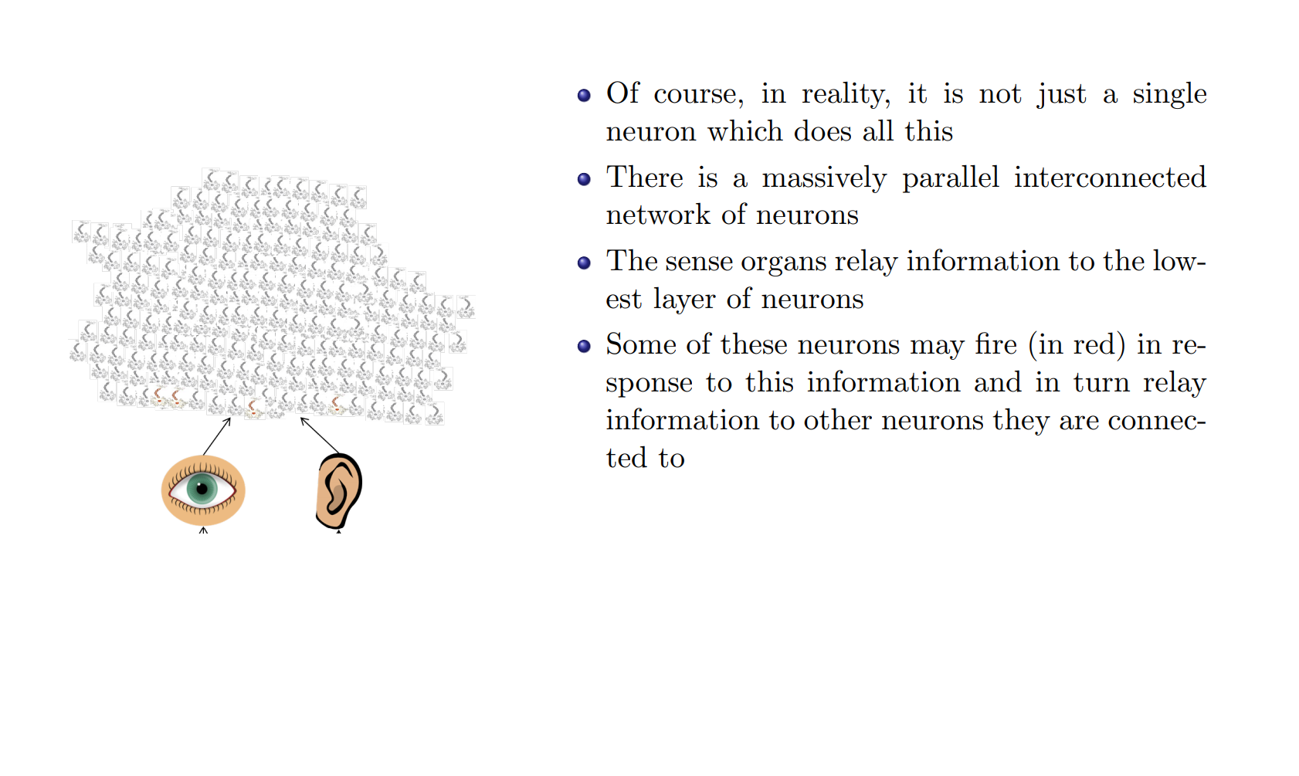

Slide 7
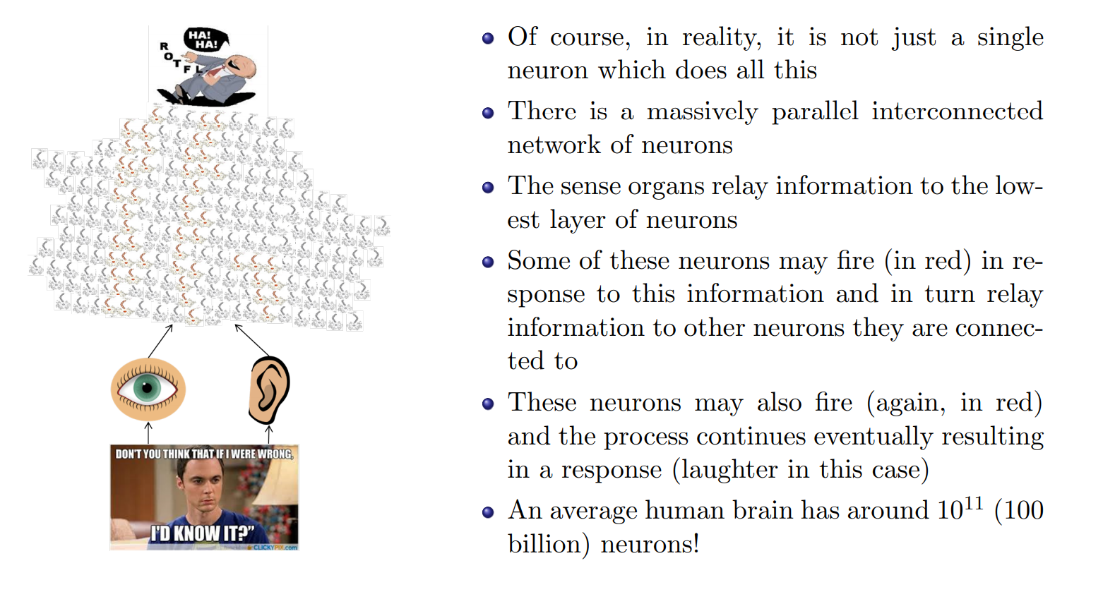

Slide 8
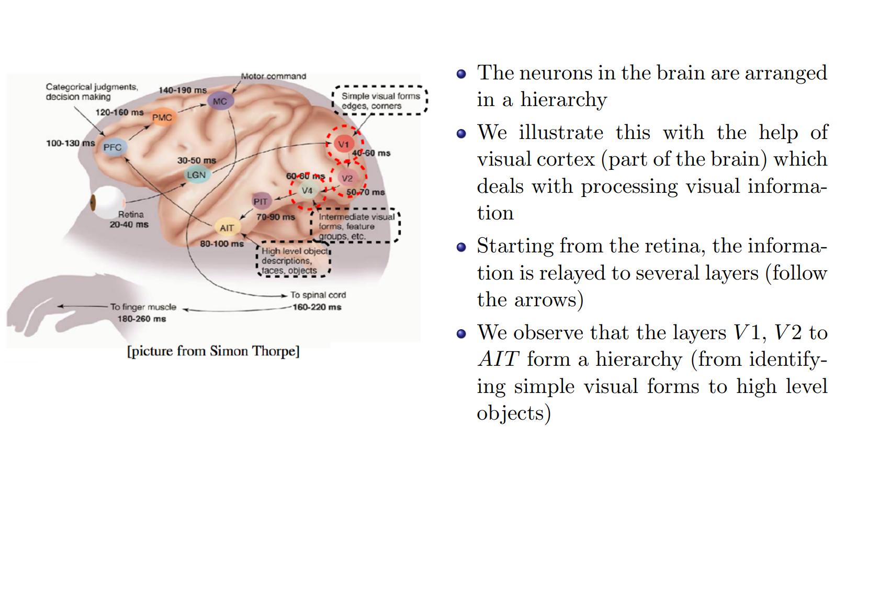

Slide 9
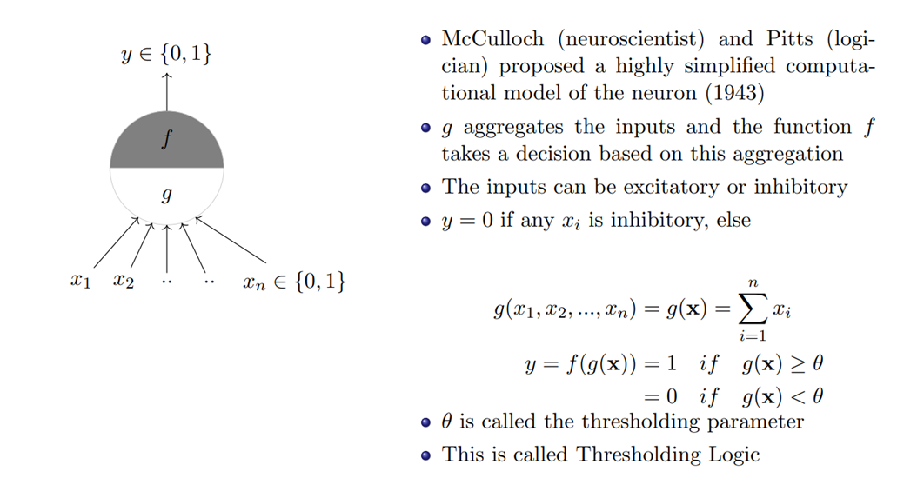
MP Neuron

Slide 10
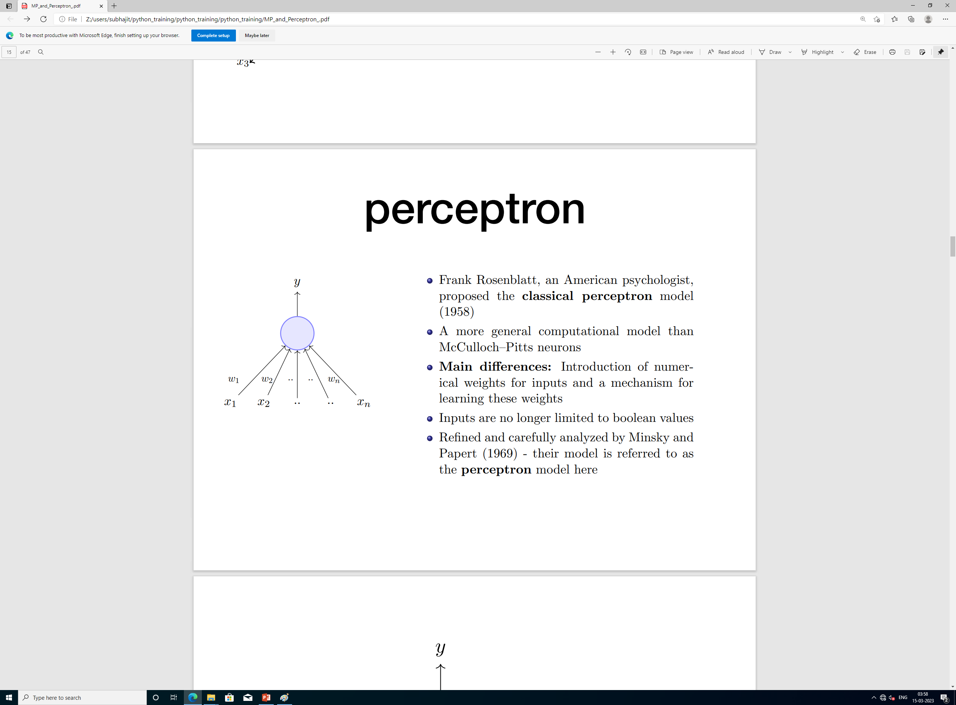
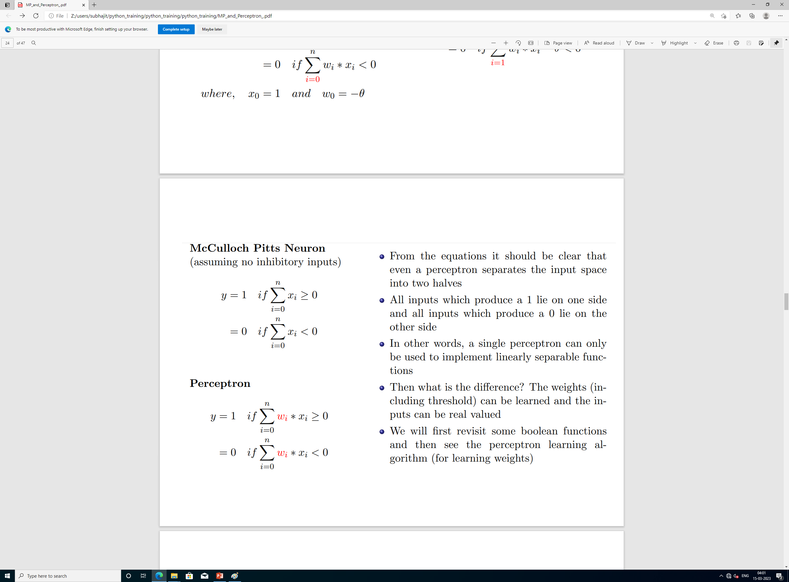
Perceptron

Slide 11
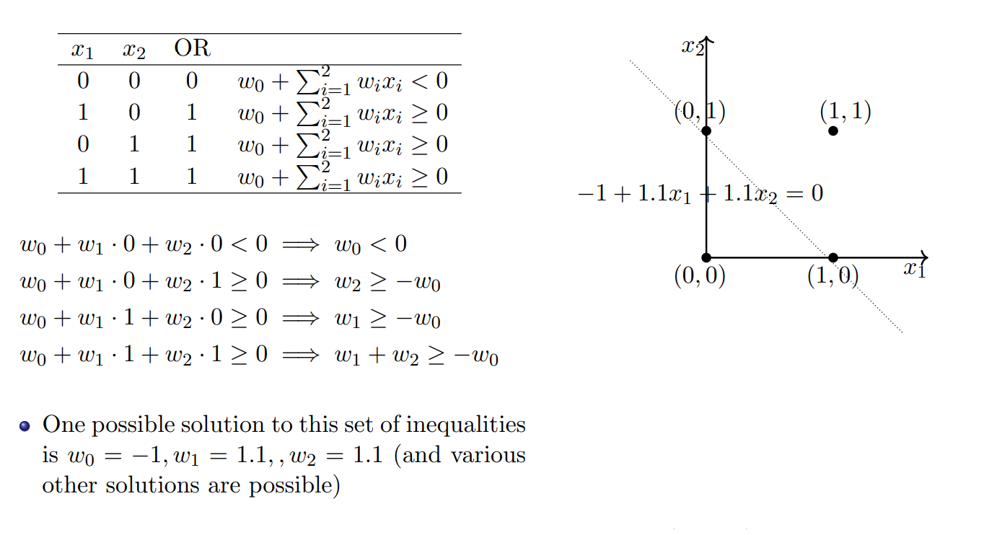
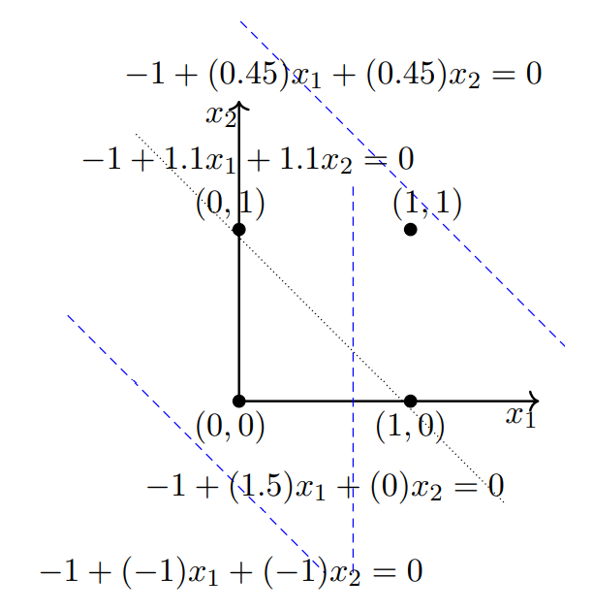
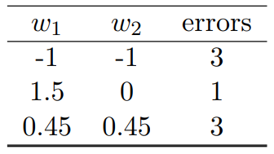
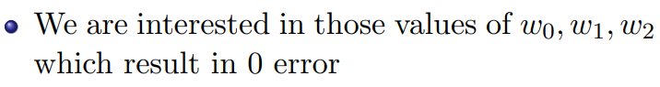
Example of Perceptron application

Slide 12
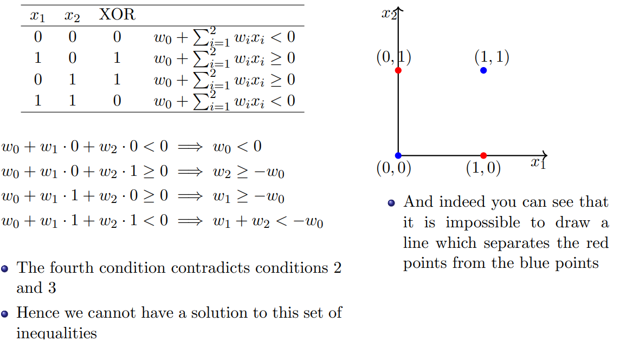
Example of Perceptron application (contd.)

Slide 13
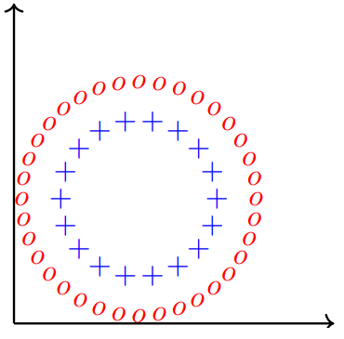
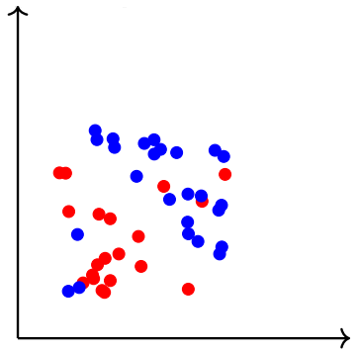
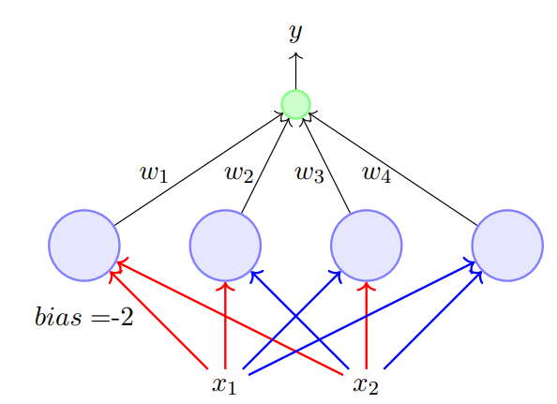
Introducing Multi-Layered Perceptron (MLP)
Most real world data is not linearly separable and will always contain some outliers
In fact, sometimes there may not be any outliers but still the data may not be linearly separable
We need computational units (models) which can deal with such data
A single perceptron cannot deal with such data, we will show that a network of perceptrons can indeed deal with such data
This network of perceptrons are called Multi-layered perceptron (MLP)

Slide 14
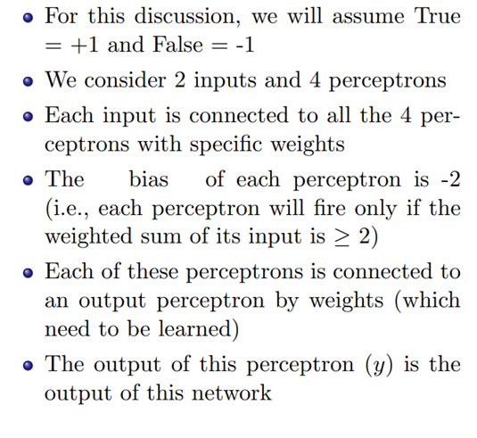
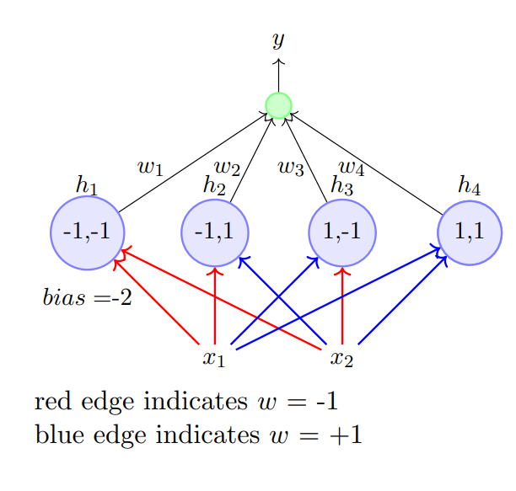
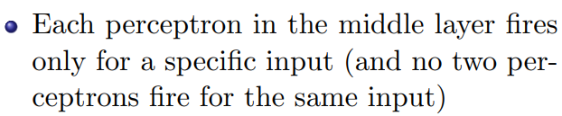
Representation power of MLP

Slide 15
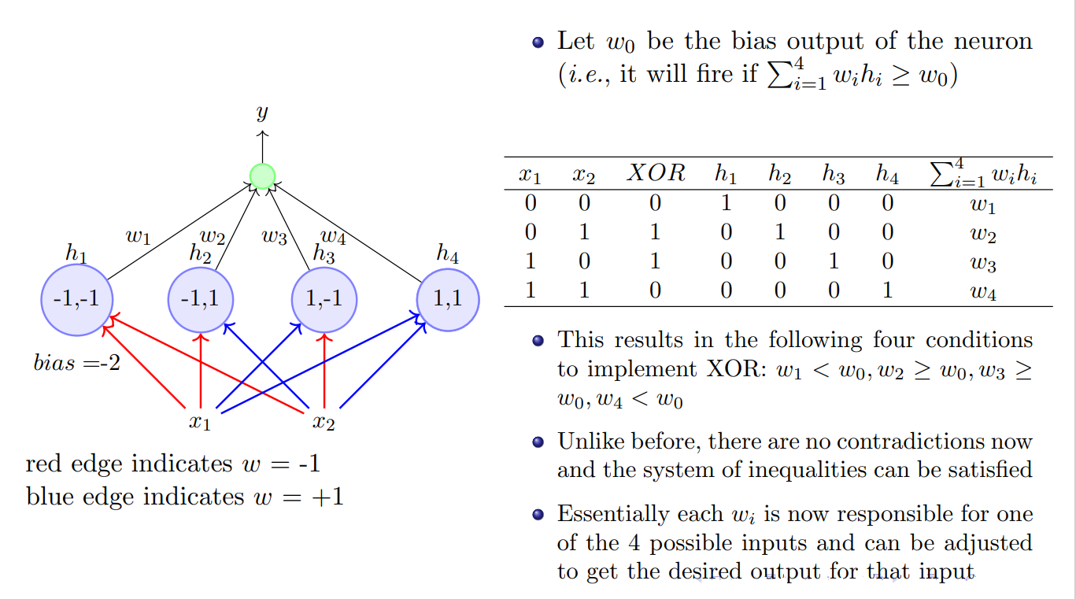
MLP Example(contd.)

Slide 16
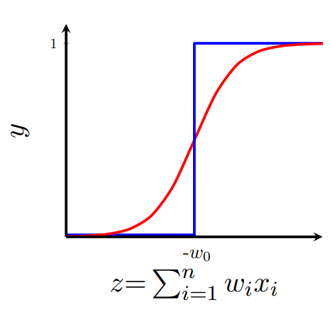
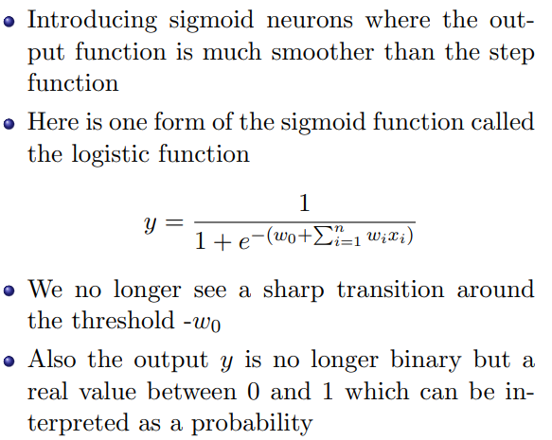
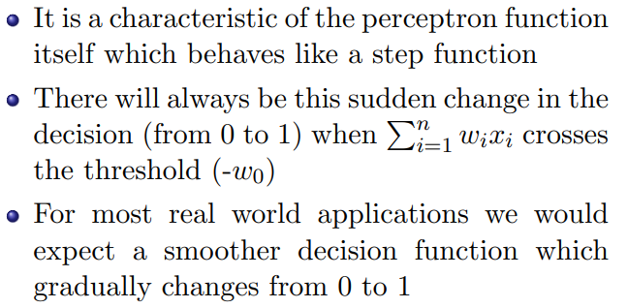
Perceptron vs logistic neuron

Slide 17
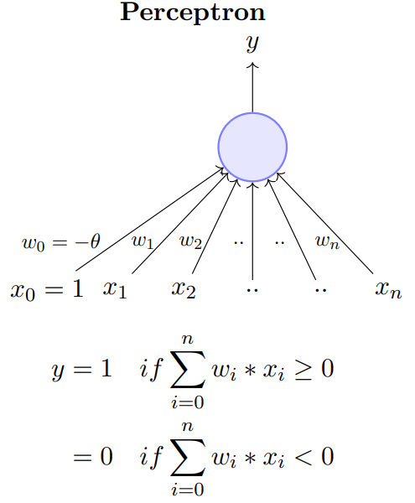
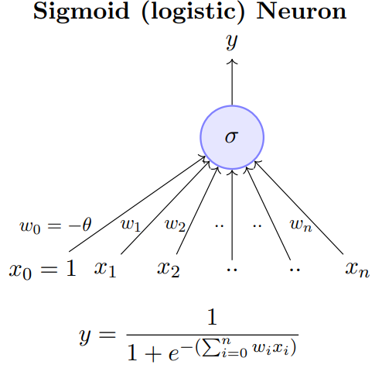
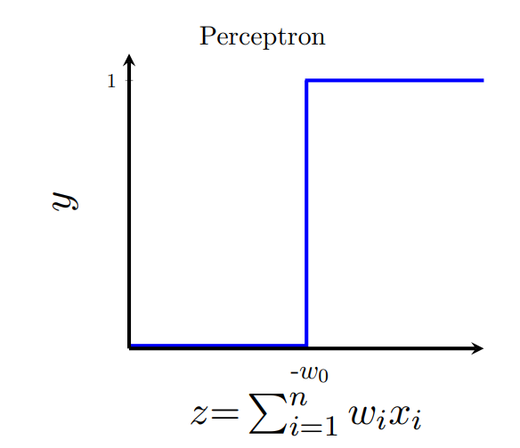
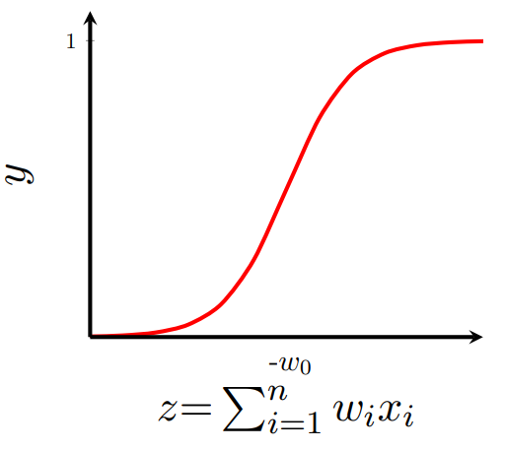

Slide 18
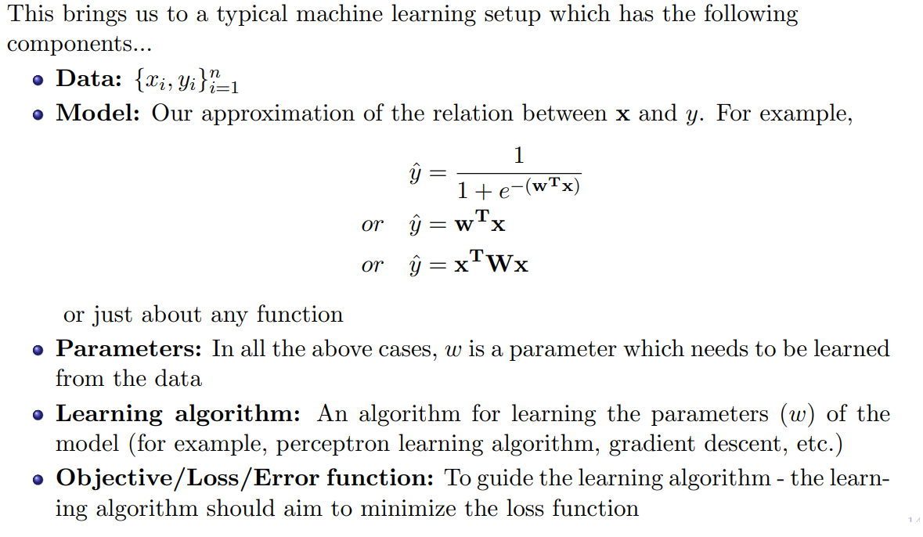
Updated Perceptron components

Slide 19
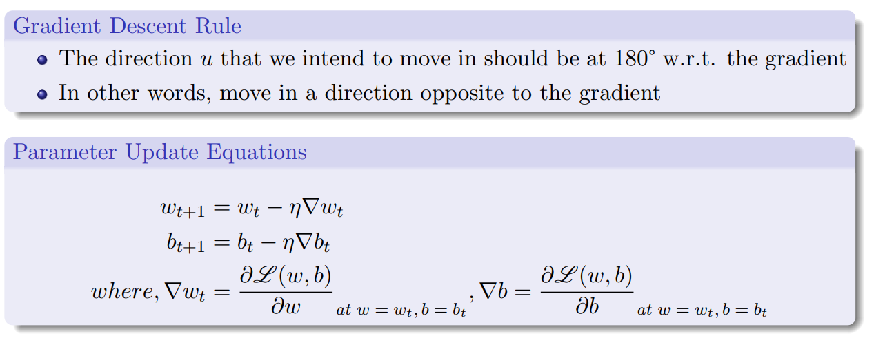
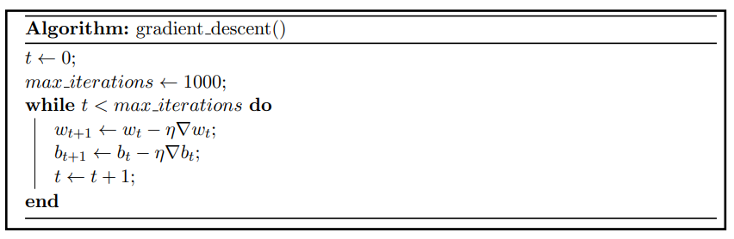
Perceptron Learning algorithm

Slide 20
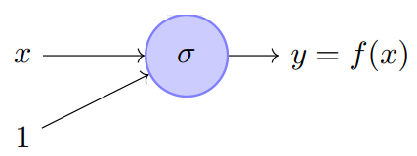
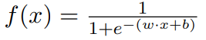
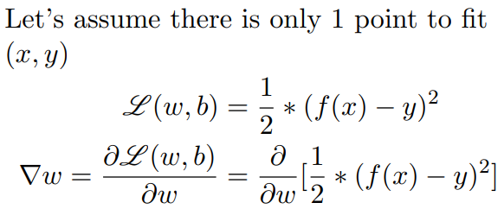
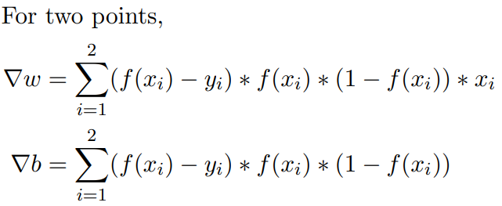
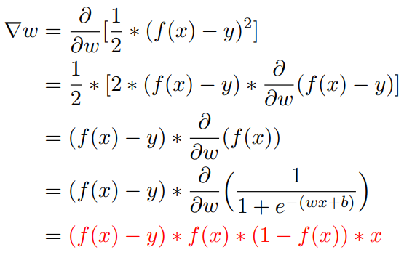
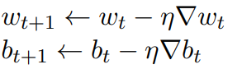
MLP Backpropagation example
Put these gradients value in gradient decent algorithm to get updated parameter at t+1 iteration
Where is learning rate

Slide 21
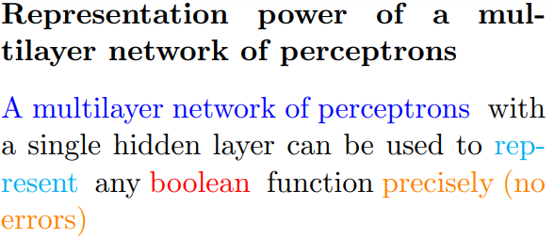
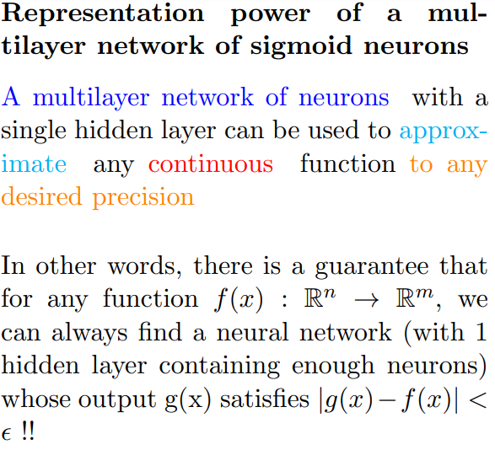
Universal Approximation Theorem

Slide 22
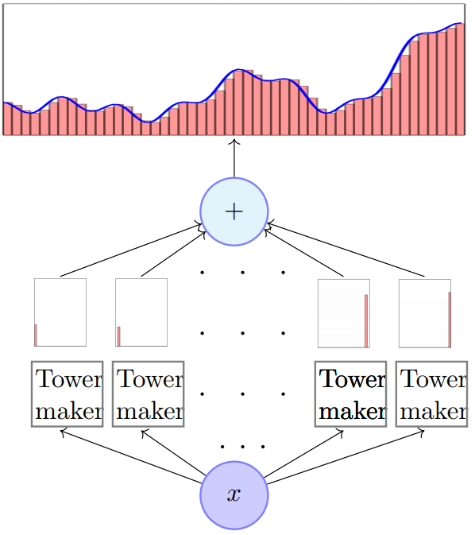
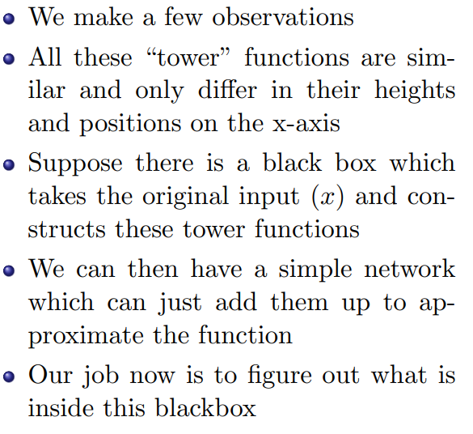
Intuitive idea for approximating a function

Slide 23
Limitation of Perceptron
3 layer MLP can easily represent any mapping from input to output
This does not mean its ability to learn, tends to memorize the training data
Poor generalization
Required size of hidden layer may be too large
It has been shown that deep networks usually requires much smaller size to approximate the same function and better generalization
Deeper layer will learn much more abstract and detailed features about the input object

Slide 24
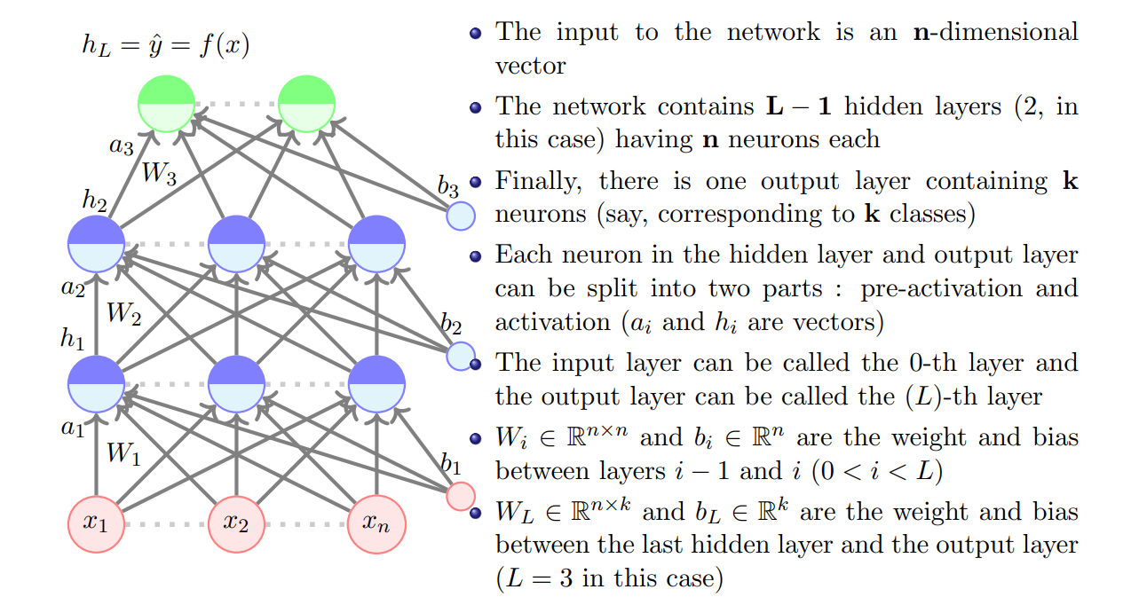
Multilayer Neural Network

Slide 25
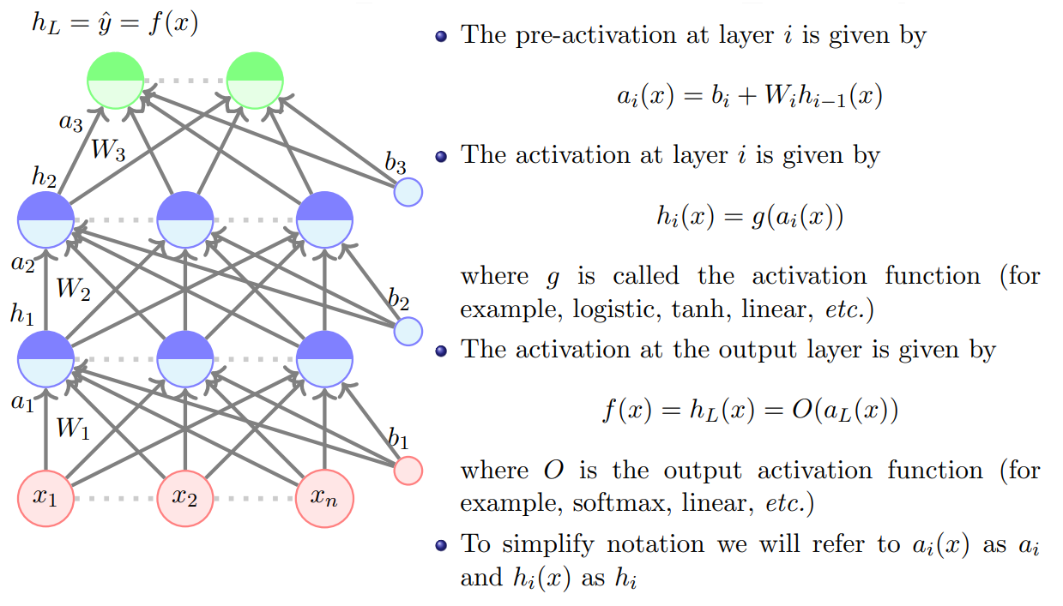
Multilayer Neural Network (contd.)

Slide 26
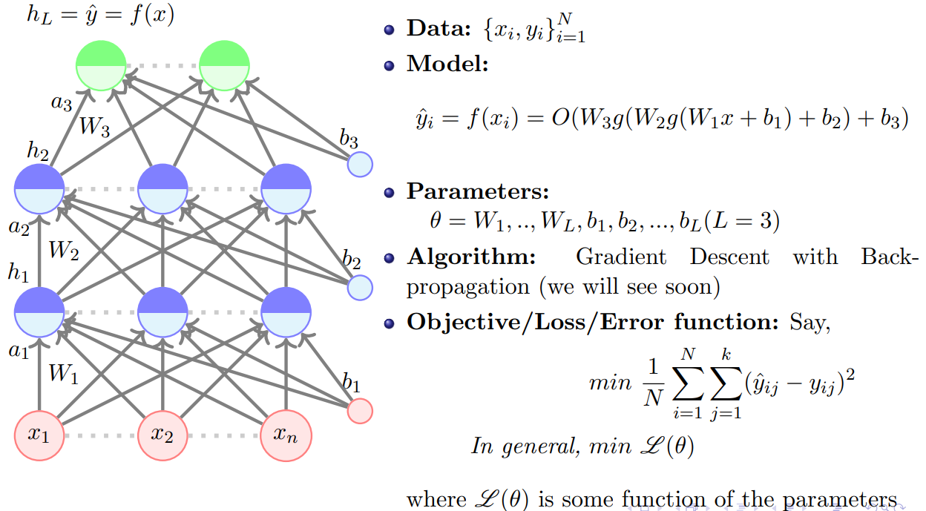
Multilayer Neural Network (contd.)

Slide 27
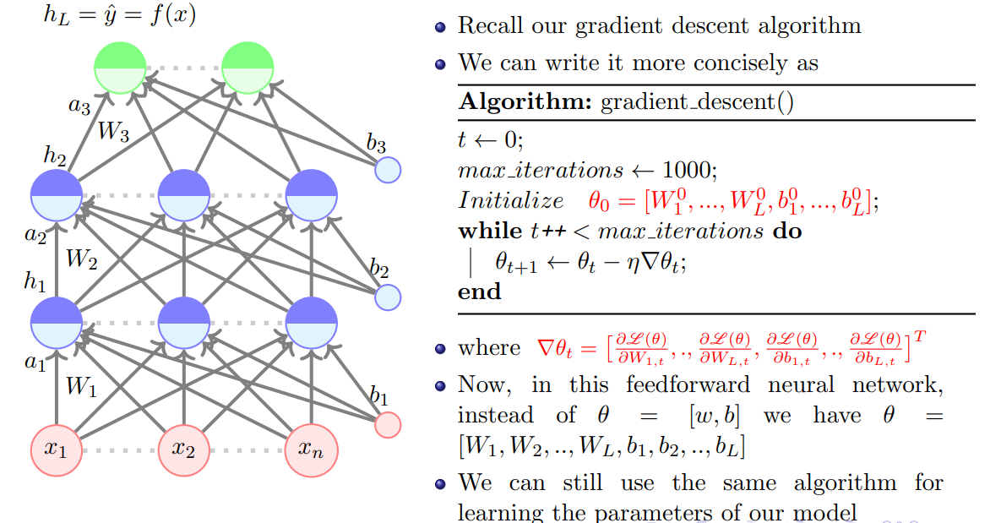
Backpropagation Learning Algorithm

Slide 28
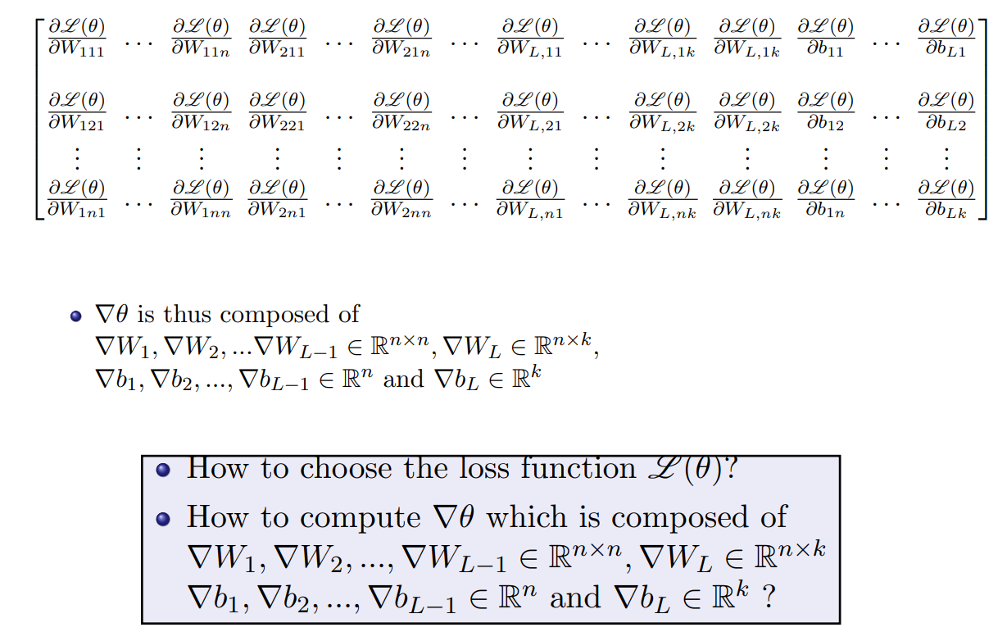
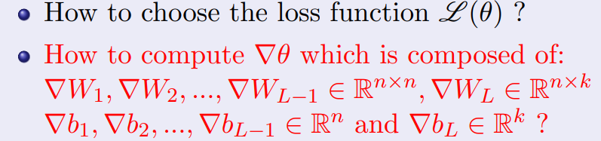
Backpropagation Learning Algorithm (contd.)

Slide 29
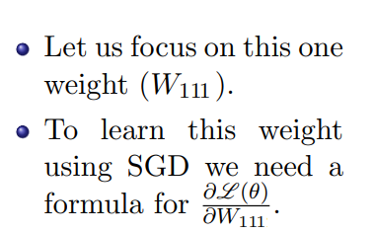




Backpropagation Learning Algorithm (contd.)

Slide 30

Backpropagation Learning Algorithm (contd.)

Slide 31





Backpropagation flow
Step 1
Step 2
Step 3
Step 5
Step 4

Slide 32

Backpropagation flow

Slide 33


Algorithms to follow for DNNs

Slide 34

Algorithms to follow for DNNs (contd.)

Slide 35

Illustration of backpropagation with computational graph

Slide 36

Illustration of backpropagation with computational graph

Slide 37

Illustration of backpropagation with computational graph

Slide 38

Illustration of backpropagation with computational graph

Slide 39

Illustration of backpropagation with computational graph

Slide 40

Illustration of backpropagation with computational graph

Slide 41


Activation Functions

Slide 42


Activation Functions (contd)
Introduces non-linearity in the network
enabling it to learn better
Differentiable everywhere
Scales down the input in the range of [0,1],
hence we get the output in terms of probability

Slide 43

Activation Functions (contd)
Normalizes the output of the neuron in the
range of [-1,1]
Differentiable everywhere
It is zero-centered function, so the optimization
of the loss function become easier
Compare to Sigmoid it is an expensive procedure
It suffers from saturation problem and vanishing
gradient problem

Slide 44

Activation Functions (contd)

Slide 45

Activation Functions (contd)

Slide 46


Limitation of ANNs and inspiration behind CNN
Sparse connectivity
Parameter sharing

Slide 47



Introducing CNNs
A Typical CNN architecture
CNN is a sequence of Convolutional Layers,
interspersed with activation functions

Slide 48

The Convolution Operation

Slide 49



Convolution layer

Slide 50

Example of Convolution operation

Slide 51


Convolution layer

Slide 52

Convolution layer

Slide 53


Convolution layer parameters and understanding receptive fields
Generally convolution layer have following parameters:
No. of filters
Kernel size
Stride
Padding
Weight initialization
Receptive field (RF) is defined as the size of the region in the input that produces the feature.
It is a measure of association of an output feature (of any layer) to the input region

Slide 54

Convolution layer (stride 1)

Slide 55

Convolution layer
Convolution layer (stride 1)

Slide 56

Convolution layer
Convolution layer (stride 1)

Slide 57

Convolution layer
Convolution layer (stride 1)

Slide 58

Convolution layer
Convolution layer (stride 1)

Slide 59

Convolution layer (stride 2)

Slide 60

Convolution layer (stride 2)

Slide 61


Convolution layer (stride 2)

Slide 62

Convolution layer (stride 3)

Slide 63

Convolution layer

Slide 64



Convolution layer with zero-padding

Slide 65

Convolution layer

Slide 66


Convolution layer

Slide 67


Convolution layer (summary)

Slide 68


CNN case study: AlexNet [Krizhevsky et al. 2012]

Slide 69


CNN case study: AlexNet [Krizhevsky et al. 2012]

Slide 70


Pooling layer

Slide 71



Max-Pooling layer

Slide 72


Normalization layer
Normalize the distribution of the intermediate layers
Enables smoother gradients, faster training, and better
generalization accuracy
Mainly 4 types:
Batch Normalization: Batch wise Gaussian normalization
before activation function, widely used
Weight Normalization: The weights are normalized with
two parameters, not stable so less usage
Layer Normalization: Normalizes the activations along the feature direction instead of mini-batch direction
Group normalization: Similar to LN, but divides the features in certain groups and normalize them separately

Slide 73

Case study: Some popular CNN architectures
AlexNet
VGG
GoogLeNet
ResNet
DenseNet
UNet

Slide 74



Case study: VGGNet [Simonyan and Zisserman, 2014]
Deeper Network
VGG16Net has double the layers (16) compared to AlexNet(8)
7.3% top 5 error in ILSVRC’14
Instead of varying kernel size of convolution layer in Alexnet, VGG uses only 3*3 convolution with stride 1, pad 1 and 2*2 MaxPool with stride 2
So major difference between AlexNet and VGGNet?

Slide 75

Case study: VGGNet [Simonyan and Zisserman, 2014]

Slide 76





Case study: GoogLeNet [Szegedy et al., 2014]

Slide 77





Case study: GoogLeNet [Szegedy et al., 2014]

Slide 78



Case study: ResNet [He et al., 2014]

Slide 79





Case study: ResNet [He et al., 2014]
v/s

Slide 80





Case study: ResNet [He et al., 2014]

Slide 81

Case study: Comparing Complexities

Slide 82

Case study: DenseNet

Slide 83

Case study: UNet

Slide 84


Slide 85
Different python libraries and steps to train a DL model
Three major steps for setting up a deep learning environment:
Dataset preparation and data preprocessing
Network design and selection of different hyperparameters
Visualization

Slide 86








Dataset preparation and data preprocesssing
Lack of public remote sensing dataset
Image processing
Numeric computation
Data manipulation and augmentation
Copyright 2019 Business over Broadway

Slide 87



Network design libraries
Popular Libraries for network desgin

Slide 88



Selection of Network parameters and hyperparameters
Selection of the network architecture and parameters depends on problem statement
We will illustrate with two example

Slide 89




Selection of Network parameters and hyperparameters (contd.)

Slide 90

Selection of Network parameters and hyperparameters (contd.)
Other hyperparameters
Optimizer: Used to calculate the gradient. SGD, ADAM, RMSProp, AdaDelta etc. ADAM is the most popular and robust
Learning Rate: Decides the amount of parameter updating steps. As training progresses it is changed based on validation performance metric
Batch size: It is number of training data samples for the input to be passed to the deep learning model.
Epoch: The no of times a whole dataset is passed to the neural network.

Slide 91

Discriminative vs Generative Networks
Discriminative model
Separates data points into different classes and learns the boundaries using probability estimates and maximum likelihood.
Till now all the models discussed is in this category.
Generative model
Used to generate new data points
Go in-depth to model the actual data distribution and learn the different data points
Estimate prior probability P(x) ad joint probability P(x,y) to estimate P(y/x)

Slide 92



Example of Generative Networks : GAN[Goodfellow,2014]
Generator (G) is a neural network model that generates images from noise
Discriminator (D) acts as critic to differentiate between real and fake
G tries to fool D
D tries not to be fooled
Models are trained simultaneously
As G gets better, D has a more challenging task
As D gets better, G has a more challenging task
Ultimately, we don’t care about the D
Its role is to force G to work harder
G and D play the following min max game
real or fake?
Discriminative Model
Real world
noise ($z$)
Generative Model

Slide 93

Some examples of application of GAN[Goodfellow,2014]
AI generated fake
celebrity faces

Slide 94

Some examples of application of GAN[Goodfellow,2014]

Slide 95

Some examples of application of GAN[Goodfellow,2014]

Slide 96


Recurrent Neural Networks (RNNs)
Recurrent Neural Networks (RNNs) are a family of neural networks introduced to learn sequential data.
RNNs can be applied to various type of sequential data to learn the temporal patterns.
Time-series data (e.g., stock price) → Prediction, regression
Raw sensor data (e.g., signal, voice, handwriting) → Labels or text sequences
Text → Label (e.g., sentiment) or text sequence (e.g., translation, summary, answer)
Image and video → Text description (e.g., captions, scene interpretation)
Recurrent Neural Networks are networks with loops, allowing information to persist.
In the above diagram, a chunk of neural network, A = f_{W}, looks at some input xt and outputs a value ht. A loop allows information to be passed from one step of the network to the next.

Slide 97


Recurrent Neural Networks (RNNs)
The recurrent structure of RNNs enables the following characteristics:
Specialized for processing a sequence of values $x^{\left(1\right)}, …, x^{\left(τ\right)}$
Each value $x^{\left(i\right)}$ is processed with the same network A that preserves past information
Can scale to much longer sequences than would be practical for networks without a recurrent structure
Reusing network A reduces the required amount of parameters in the network
Can process variable-length sequences
The network complexity does not vary when the input length change
However, vanilla RNNs suffer from the training difficulty due to exploding and vanishing gradients.

Slide 98



RNN: Network with Memory
Vanilla RNN operates in a “multiplicative” way (repeated tanh).
Two recurrent cell designs were proposed and widely adopted:
Long Short-Term Memory (LSTM) (Hochreiter and Schmidhuber, 1997)
Gated Recurrent Unit (GRU) (Cho et al. 2014)
Both designs process information in an “additive” way with gates to control information flow.
Sigmoid gate outputs numbers between 0 and 1, describing how much of each component should be let through.
LSTM is a complicated and parameter hungry model and recurrent nature also makes it difficult to leverage parallel computation, resulting in an extremely slow training time
Introduction of Transformer [Vaswani et al. 2017]
Standard LSTM Cell
GRU Cell
A Sigmoid Gate

Slide 99

Different types of RNN based on application
Image Captioning
Sentiment Analysis
Machine Translation
Video Classification

Slide 100
Different vision applications of Deep Learning models
Major applications of deep neural networks in computer vision domain
Image Classification
Image Classification with localization
Object Detection
Object Segmentation
Image style transfer
Image Colorization
Image Reconstruction
Image Super-Resolution
Image Synthesis
Image Restoration
Other Problems: This includes image captioning [1]- generating captions for a given input image, text to image synthesis [2]- synthesizing an image based on textual description etc.
[1] Show and Tell: A Neural Image Caption Generator, 2014
[2] AttnGAN: Fine-Grained Text to Image Generation with Attentional Generative Adversarial Networks, 2017

Slide 101

Object detection and image classification

Slide 102
Object and Image Segmentation
Popular models: FCN, UNet, Mask R-CNN

Slide 103
Image Style Transfer
Popular models: BART, StyTr2

Slide 104
Image Colorization
Colorful Image Colorization, 2016.
Let there be Color!: Joint End-to-end Learning of Global and Local Image Priors for Automatic Image Colorization with Simultaneous Classification, 2016.
Deep Colorization, 2016.

Slide 105
Image Reconstruction
Highly Scalable Image Reconstruction using Deep Neural Networks with Bandpass Filtering, 2018.
Image Inpainting for Irregular Holes Using Partial Convolutions, 2018.
ALERT: Adversarial Learning with Expert Regularization using Tikhonov Operator for Missing Band Reconstruction

Slide 106
Image Super-resolution
Popular models: SRGAN, ESRGAN,
Swin-IR

Slide 107
Image Restoration (Denoising in Cartosat-3 MX data)

Slide 108
Image Restoration (Underlap correction in Cartosat-3 MX data)

Slide 109
Others (AI enabled social distance indicator and automatic temperature monitoring)
Social distance indicator

Slide 110
Summary
Definition of single layer perceptron and its limitations
How MLP applies for non linear separable objective
Introduction of ANN and how backpropagation works with illustration
Limitation of ANN and inspiration behind CNN
Introduction of CNN and convolution operation with its different parameters
Case study of popular CNN models
Different python libraries related to Deep learning and its different steps for training
Brief introduction to RNN and GANs
Illustration of different types of vision applications carried out in our division using DL

Slide 111
Thank You

Slide 112


